Slide 2
Kotlin workshop for beginners

Slide 3
Agenda
Introduction
Kotlin Basics
Spring Boot with Kotlin
Project Setup
Hands-On Coding
Wrap-Up

Slide 4
Kotlin features
Immutable by default: val, data class
when instead of switch
?., ?:, and null-safety
Extension functions and lambdas
open vs final by default
Top-level functions

Slide 5
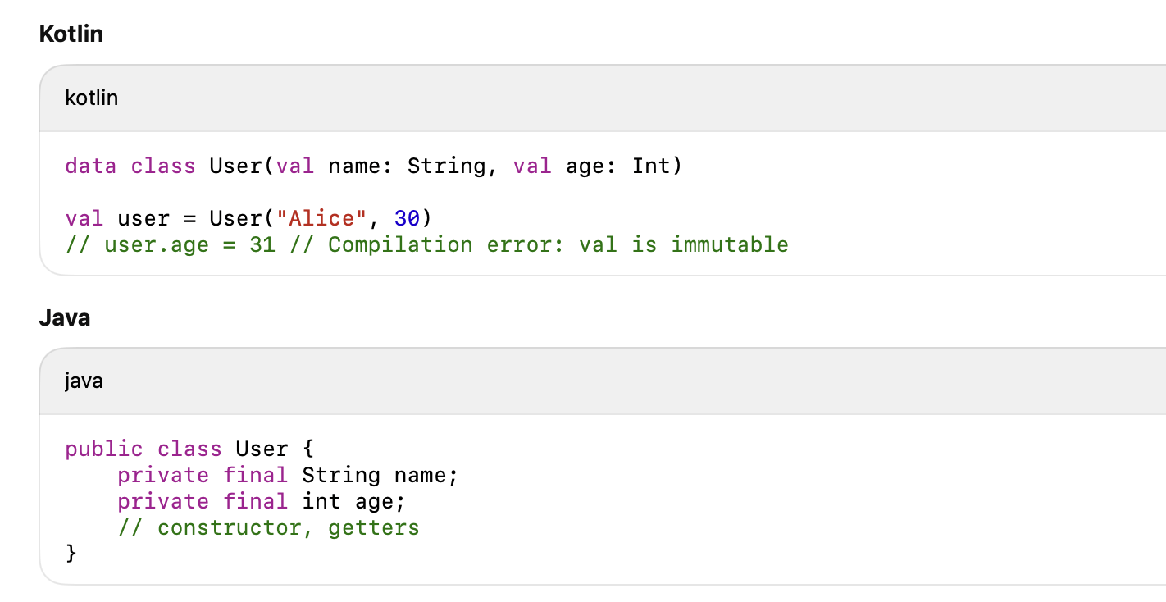
Immutable by Default (val, var, data class)
Key Point: val creates read-only variables. data class automatically adds equals, hashCode, toString, etc.

Slide 6
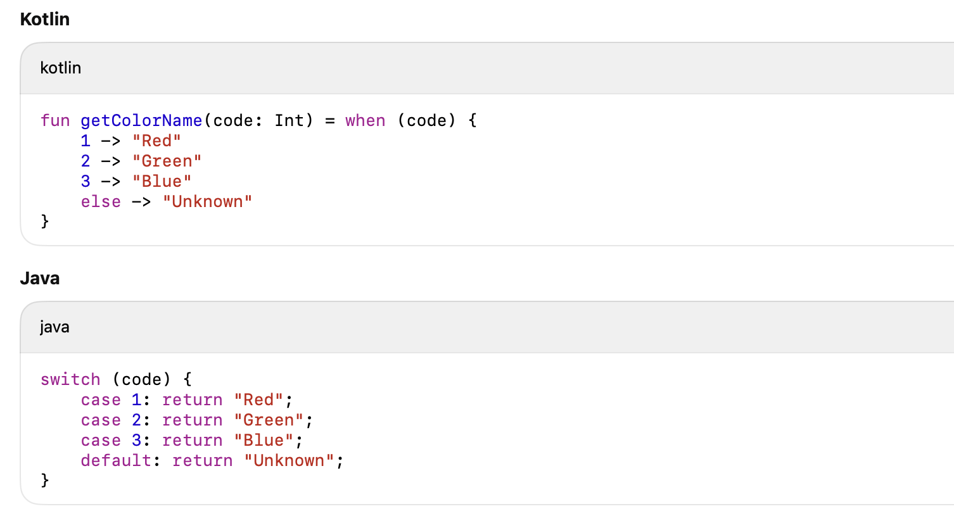
when Instead of switch
Key Point: when is an expression, concise, and supports ranges and complex conditions.

Slide 7
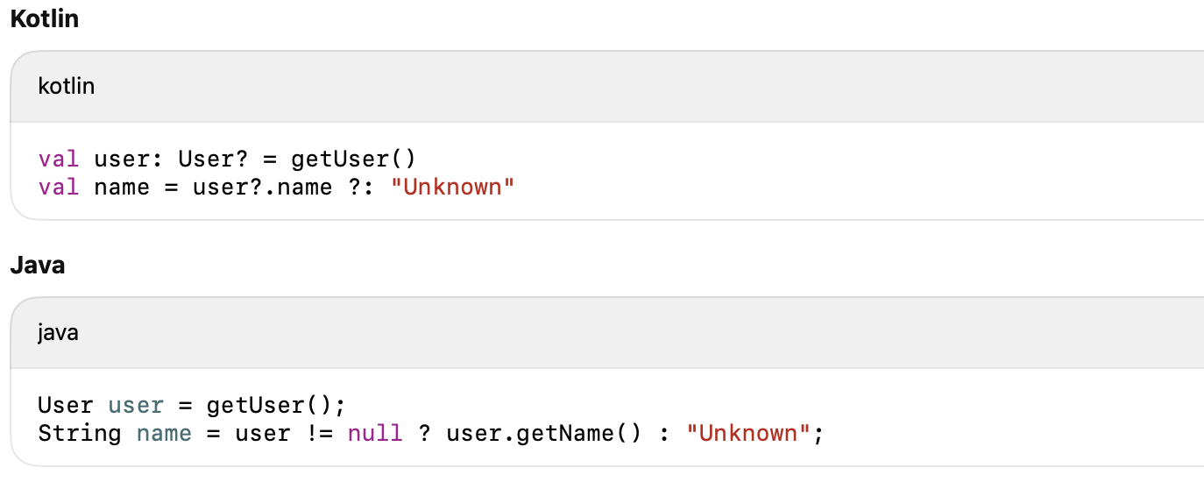
Null Safety (?., ?:, !!)
Key Point: No more NullPointerException traps by default; null safety is part of the type system.

Slide 8
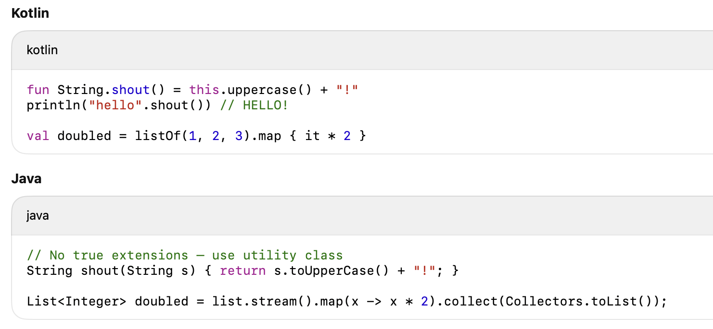
Extension Functions & Lambdas
Key Point: Extensions make APIs more fluent. Lambdas are first-class citizens.

Slide 9
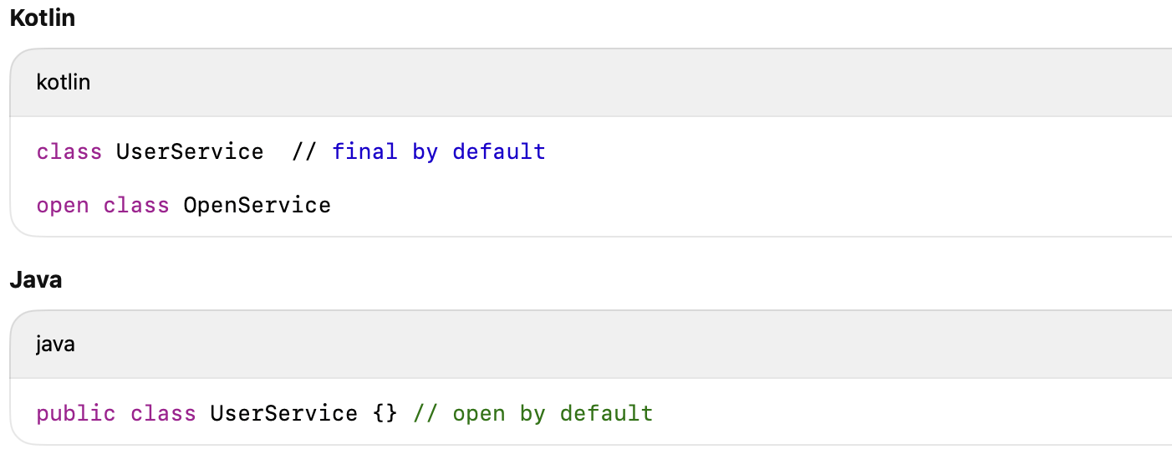
open vs final Classes
Key Point: Kotlin classes and methods are final by default — you must explicitly mark them open to allow inheritance (important for Spring).

Slide 10
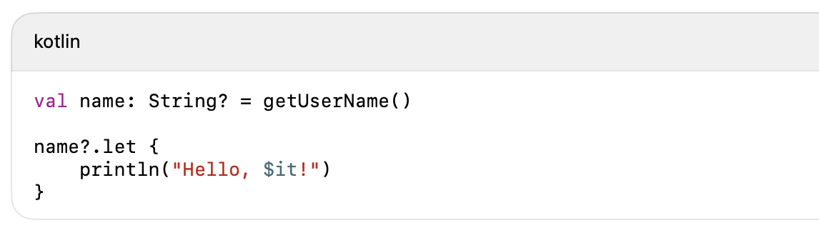
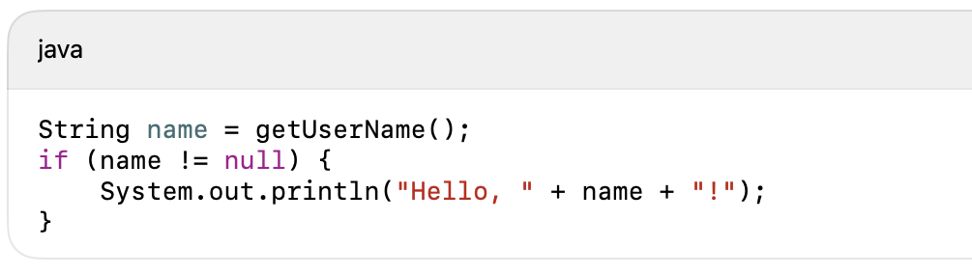
let in Kotlin
.let:
Executes the lambda only if name is not null
it refers to the object inside the lambda
Why use let?
Null safety in a concise way
Scoped temporary variables
Cleaner chaining in functional style

Slide 11
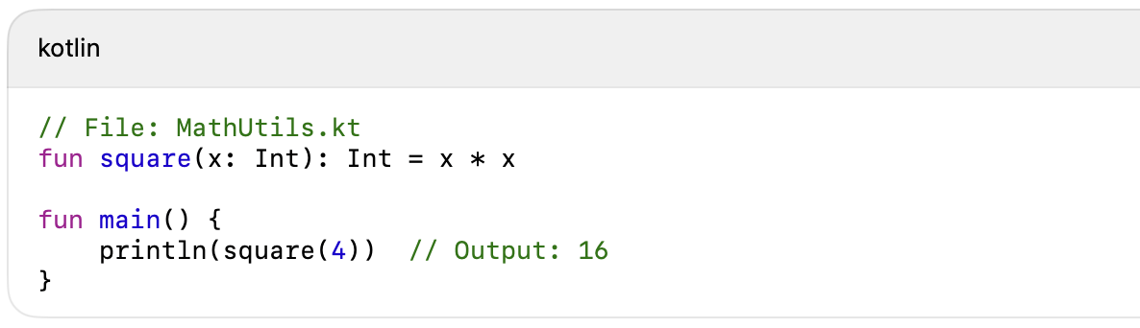
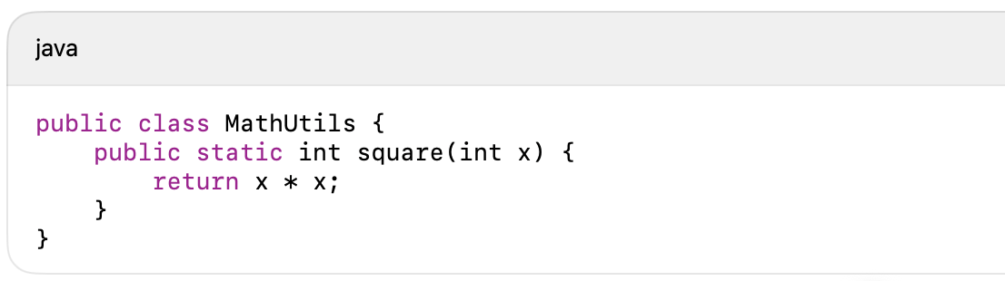
Top-Level Functions
Kotlin allows functions to be declared outside of any class — directly in a file.
No need for utility classes like Utils or Helpers
Functions can be imported directly with import
import MathUtilsKt.square

Slide 12
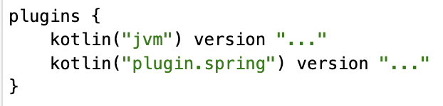
Spring Boot + Kotlin Setup
Language-specific needs:
Kotlin compiler plugin
Spring plugin which automatically opens classes and methods (unlike in Java, the default qualifier is final in Kotlin)
Use Initializr web https://start.spring.io/ or built in version in Idea ultimate
Required plugins:
Create a Spring Boot project with Kotlin https://kotlinlang.org/docs/jvm-create-project-with-spring-boot.html#run-the-application
Building web applications with Spring Boot and Kotlin https://spring.io/guides/tutorials/spring-boot-kotlin

Slide 13

Practice agenda
What you’ll build:
Distributed ring messenger using Spring Boot + Kotlin based on spring boot application template
What you’ll practice:
Kotlin basics through teamwork
Writing your own microservice
Debugging distributed message flows

Slide 14
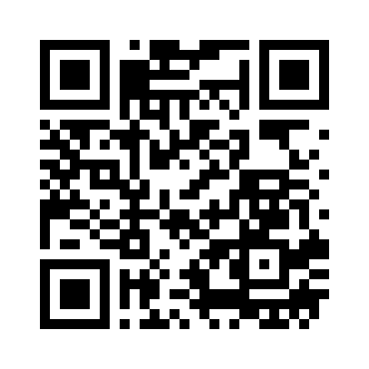
Project Setup
Clone the Starter Project git@github.com:OctoOsmo/KotlinRing.git
What’s inside:
Pre-configured Spring Boot project
Kotlin setup with required plugins
Single REST endpoint as an example

Slide 15
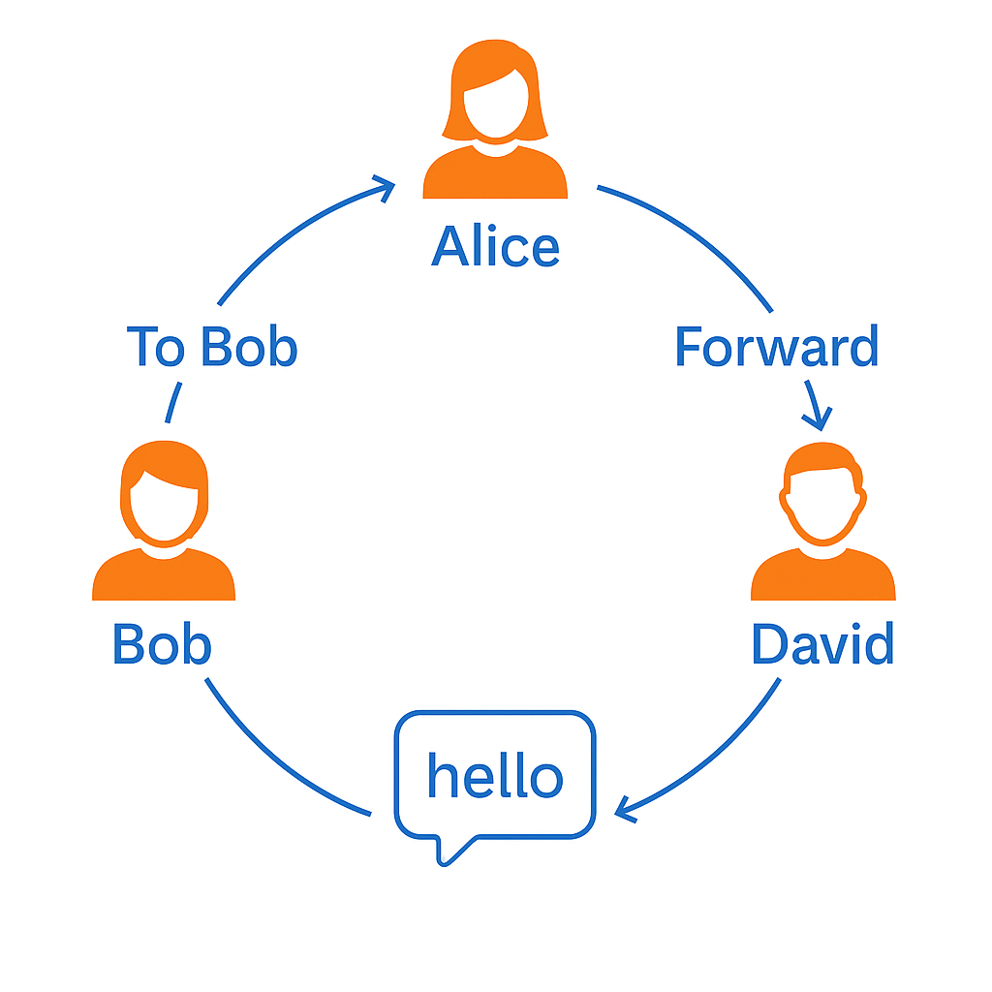
Task
Build a simple Spring Boot microservice in Kotlin that can:
Accept a message via a POST endpoint
Forward the message to the next participant in the ring
Log received messages with full metadata to standard output
Forwarding Rules:
If to ≠ your login → forward to next node in the ring
Add your login & timestamp to hops
If to = your login → print full message with metadata

Slide 16
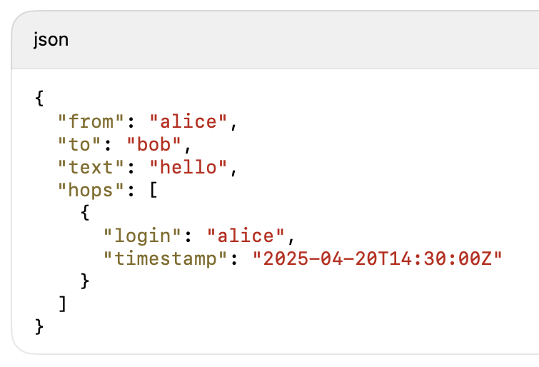
Requirements
Use Kotlin for all code
Use provided project skeleton
Define your login name as a constant
Implement a single endpoint: POST /message
Message Format:

Slide 17
What We Practiced Today
Top-level functions
let and other scope functions
val / var and Kotlin types
Null-safety
Data classes
Default values & named arguments
Simplicity of Spring Boot with Kotlin
Open vs Final classes in Spring

Slide 18
Kotlin from Java Perspective
Cleaner syntax, less boilerplate
Safer null-handling
Immutable-by-default
Seamless Spring Boot integration
More expressive code

Slide 19
Thank You & What’s Next?
🔧 Keep experimenting — try refactoring a small Java service to Kotlin
🧩 Propose topics for next session
🧑‍💻 Contribute to the Kotlin Ring Messenger on GitHub
📚 Resources:
kotlinlang.org
Spring Boot + Kotlin Guide
GitHub Repository

Slide 20
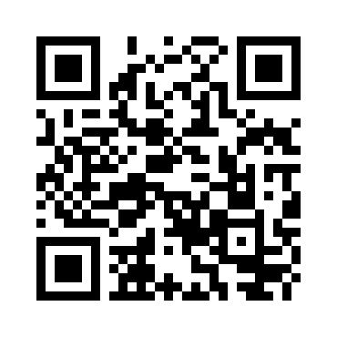
Feedback Time
What worked well?
What was confusing?
What would you change for next time?
Share your thoughts via our feedback form or QR code.

